Slide 1

Franchise as Another Form of Ownership

Slide 2

What is a Franchise
Cost to owning a Franchise
Explain the advantages and disadvantages of franchising
Importance of a Franchise Disclosure Document
What is a Franchise Agreement

Slide 3

When you imagine starting a new business, the process of developing your own business idea and the ownership type can be daunting.
What three type of ownership have we learned about?
- Sole Proprietorship
- Partnership
- Corporations
Another Great Option for you is a Franchise.

Slide 4


Table Talk Activity
What is a Franchise?
Discuss at your table for 1 minute.
Mrs. Vetter will call on one or more table to respond.

Slide 5
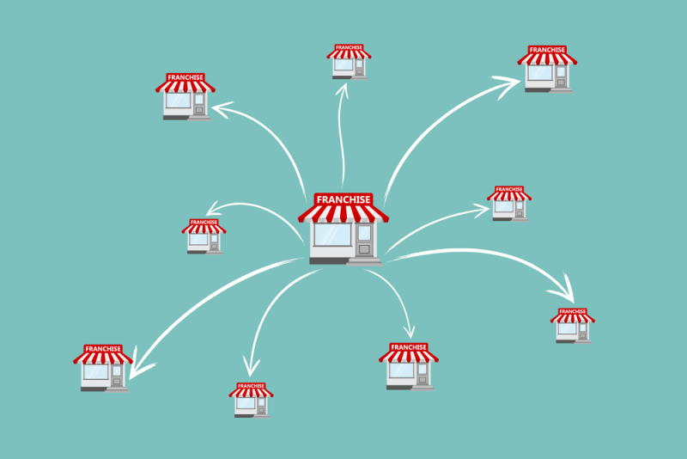
What is a Franchise?
Franchise: a licensing arrangement under which an owner licenses its operations in a set location —along with its name, trademark, products, branding, marketing and knowledge—in exchange for a franchise fee.

Slide 6
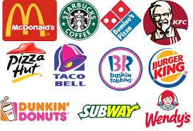

What is a Franchise?
A type of business ownership
Franchising allows you to launch a new business with the support of a successful brand and backed by a proven business model

Slide 7
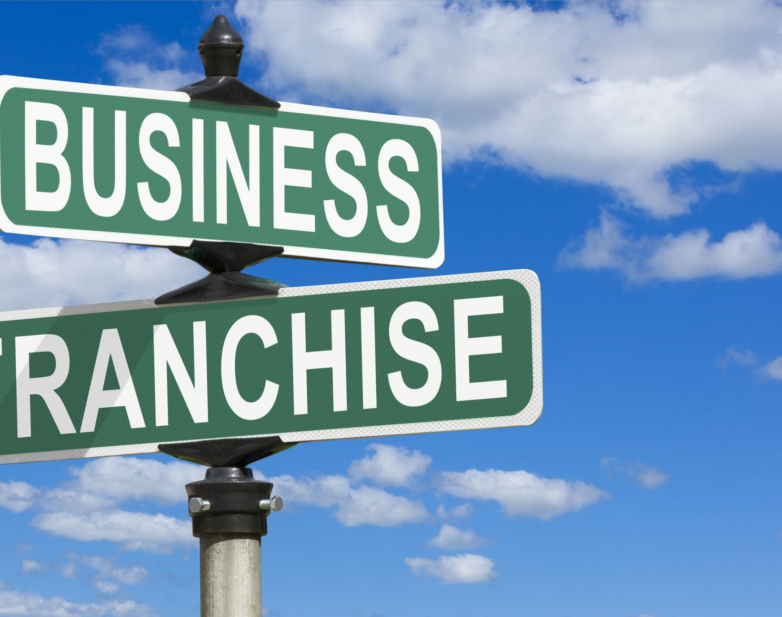
Key Players of a Franchise
Franchisor: The company that owns the overall brand and business model
Franchisee: The individual or group that buys the right to open a franchise location

Slide 8

How Does a Franchise Work?
Franchisor provides:
  Brand name
  Business model
  Training and support
Franchisee provides:
  Initial investment
  Ongoing fees
  Day-to-day management

Slide 9
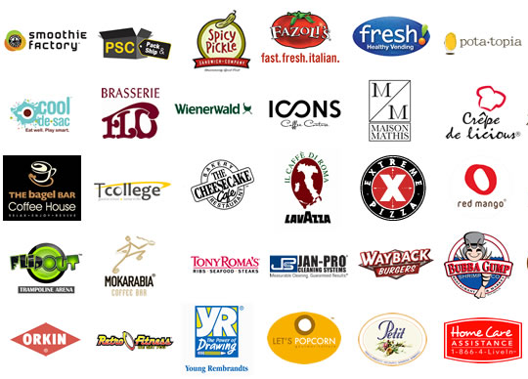
While franchises are usually associated with restaurants, any kind of business can be operated as a franchise. Some examples are:
  Fast Food: McDonald's, Subway, Burger King
  Retail: 7-Eleven, The UPS Store
  Hotels: Marriott, Hilton
  Services: H&R Block, Jiffy Lube

Slide 10

McDonald’s as a Franchise
Go to Ed puzzle posted on Google Classroom and complete the video on How much money you can make if you owned the McDonald’s franchise.

